Slide 2
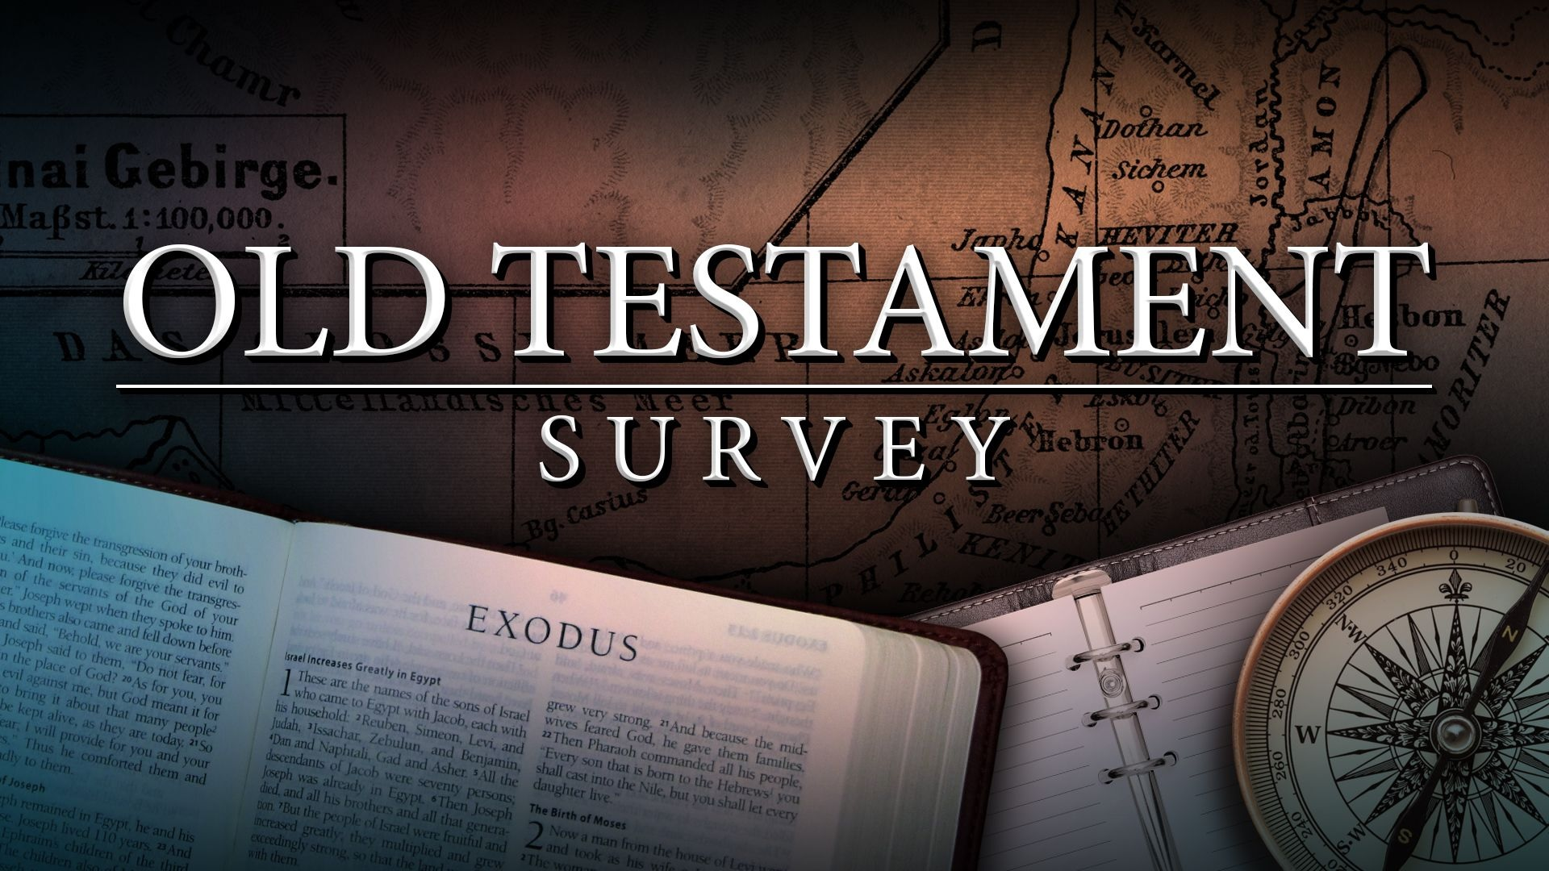
Southeast Georgia
School of the Bible

Slide 3
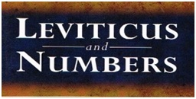
Southeast Georgia
School of the Bible

Slide 4
The Book of Leviticus
Author: Moses
“The Lord spake unto Moses” – 33 times in 27 chapters
Date: Written between 1445-1400 B.C.
The First Month of the Second Year – Exodus 40:17 And it came to pass in the first month in the second year, on the first day of the month, that the tabernacle was reared up.
Leviticus covers 1 month while Israel encamped at Sinai (Exodus-431 years)

Slide 5
Theme: Holiness
    Leviticus Answers 2 Questions:
How can sinful men approach a Holy God?
    By means of a Sacrifice - Propitiation
    By means of a Mediator - Mediation
How can man live in communion with a Holy God?
    A. 1 John 1:7; Lev. 19:1-2
    B. “Holiness” –Separated Unto God & From Evil

Slide 6
Key Verses
Leviticus 16:34
And this shall be an everlasting statute unto you, to make an atonement for the children of Israel for all their sins once a year. And he did as the LORD commanded Moses.
Leviticus 20:26
And ye shall be holy unto me: for I the LORD am holy, and have severed you from other people, that ye should be mine.

Slide 7
Outline of Leviticus
The Ground of Fellowship – Sacrifice (Ch. 1-17)
    Our Way to God – by Sacrifice
The Walk of Fellowship – Separation (Ch. 18-27)
    Our Walk with God – by Sanctification
Key Words
“Holiness” – 87 times
“Holy” – 65 times
Notes:
56

Slide 8
Key Verses
Leviticus 16:34
And this shall be an everlasting statute unto you, to make an atonement for the children of Israel for all their sins once a year. And he did as the LORD commanded Moses.
Leviticus 20:26
And ye shall be holy unto me: for I the LORD am holy, and have severed you from other people, that ye should be mine.

Slide 9
Special Features
5 Offerings
“B-M-P-S-T”
  Burnt - Redemption
Meat - Propitiation
Peace - Reconciliation
Sin - Justification
Trespass – Regeneration
Leviticus 16
“The Day of Atonement”
7 Feasts
“P-U-F-P-T-A-T”
  1-Passover
  2-Unleavened Bread
  3-Firstfruits
  4-Pentecost
  5-Trumpets
  6-Atonement
  7-Tabernacles
Notes:
58

Slide 10
Christ In The Book
Aaron
“Christ is our High Priest”
  *Hebrews 9:7, 11-12
Sacrificial Offerings
“Christ is the Final Offering for sin”
  *Hebrews 9:13-14, 24-26
Leviticus 16
“The Day of Atonement”
Notes:
58

Slide 11
Southeast Georgia
School of the Bible

Slide 12
Southeast Georgia
School of the Bible

Slide 13

Notes:
62

Slide 14
Southeast Georgia
School of the Bible

Slide 15
Southeast Georgia
School of the Bible

Slide 16
The Book of Numbers
Author: Moses
Numbers 33:2 And Moses wrote their goings out according to their journeys by the commandment of the LORD: and these are their journeys according to their goings out.
There are 80 internal claims of Mosaic Authorship
Date: Written between 1445-1400 B.C.
Begins with the Second Month of the Second Year
Numbers 1:1 And the LORD spake unto Moses in the wilderness of Sinai, in the tabernacle of the congregation, on the first day of the second month, in the second year after they were come out of the land of Egypt…

Slide 17
Theme: The Goodness and Severity of God
    Romans 11:22
    “Behold therefore the goodness and severity of God…”
Severity – to the OLD Generation
    Those 20 years old and upward were killed-(14:29-35)
    They would not believe God-(14:11)
    “Disbelief brings Destruction”
Goodness – to the NEW Generation
    A. God gave them protection & provision
    B. God gave them opportunity to believe & receive

Slide 18
Key Words
“Sojourned”
“Wilderness Wanderings”
Numbers covers some 40 yrs. of "wandering in the wilderness"
"Numbering" of the people
Men Numbered--20 yrs. old & above
Not Numbered-Levites, women, & the children under 20 yrs. old

Slide 19
Outline of Numbers
THE OLD GENERATION… (Sinai to Kadesh)
Set Aside (Ch. 1-14)
Counted
Counseled
Chastise
Condemned
II. THE TRANSITION ERA (Ch. 15-20… (In the Wilderness)
II. THE NEW GENERATION… (Kadesh to Moab)
Set Apart (Ch. 21-36)
Journeyings
Numberings
Offerings
Dividings

Slide 20
Key Verse
Numbers 33:1
These are the journeys of the children of Israel, which went forth out of the land of Egypt with their armies under the hand of Moses and Aaron.

Slide 21
Special Features
2 Numberings
1-“Mt. Sinai” – 603,550
Numbers 1:46
2- “Moab” – 601,730
Numbers 25:51
      Leviticus 16
“The Day of Atonement”
Israel wandered 1 year for every day the spies were in the land living in unbelief
The trip from Horeb to Kadesh-Barnea is only 11 days journey (Deut. 1:2)
It took only 40 hours to get Israel out of Egypt but it took 40 years to get Egypt out of Israel
Notes:
58

Slide 22
Christ In The Book
Pillar of Cloud by Day
Pillar of Fire by Night
(9:15-23)
Aaron’s Death
(marked the end of the Wandering)
(20:23-29)
The Brazen Serpent
(21:1-9; John 3:14-18)
Six Cities of Refuge
(35:6-12)
Notes:
58

Slide 23
Key Verse
Numbers 33:1
These are the journeys of the children of Israel, which went forth out of the land of Egypt with their armies under the hand of Moses and Aaron.

Slide 24
Southeast Georgia
School of the Bible

Slide 25
Southeast Georgia
School of the Bible

